Slide 1
Building a Serverless Discord bot in Azure Functions
The PoSh Wolf
https://github.com/theposhwolf/sessions

Slide 2
Who is The PoSh Wolf?
Anthony Howell
From Eugene, OR USA so I like to
~3.3 kids, 2 dogs, 1 wife, 1 cat
In IT since 2011
Blogger (https://theposhwolf.com)
Twitter (https://twitter.com/theposhwolf)
Pluralsight author (https://pluralsight.com)
Consulting (https://howell-it.com)
Employed

Slide 3
Overview
Why?
Discord slash command process explanation
Azure Function workflow
Creating a Discord bot
Avoiding frostbite
The code itself
Command addition process
Evolution

Slide 4
Why?
Background
Money
Electricity is expensive
Azure VMs bill based on consumption
Azure Functions bill based on consumption
Professional Development
Coolness factor

Slide 5
Prerequisites
PowerShell
Discord Developer account
Azure Subscription

Slide 6
Demo Environment
Windows 10
VS Code (latest version)
PowerShell 7.2 (Azure Function)
Discord.Net.PowerShell

Slide 7
Discord Slash Commands

Slide 8
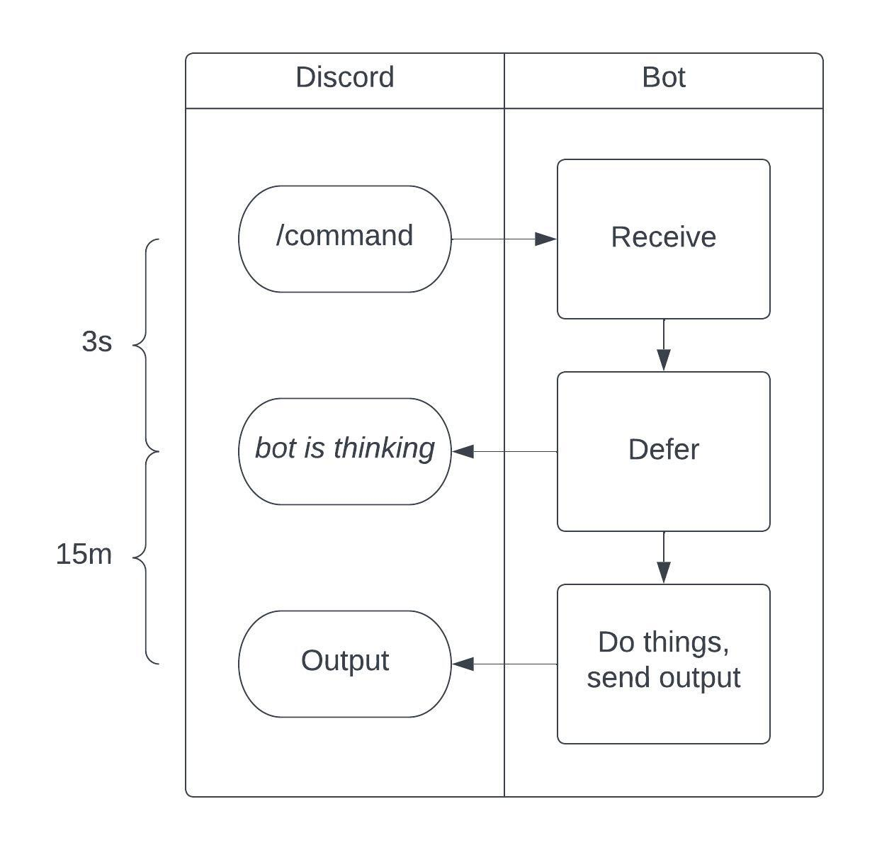

Slide 9
Slash command demo…

Slide 10
Azure Function Workflow

Slide 11
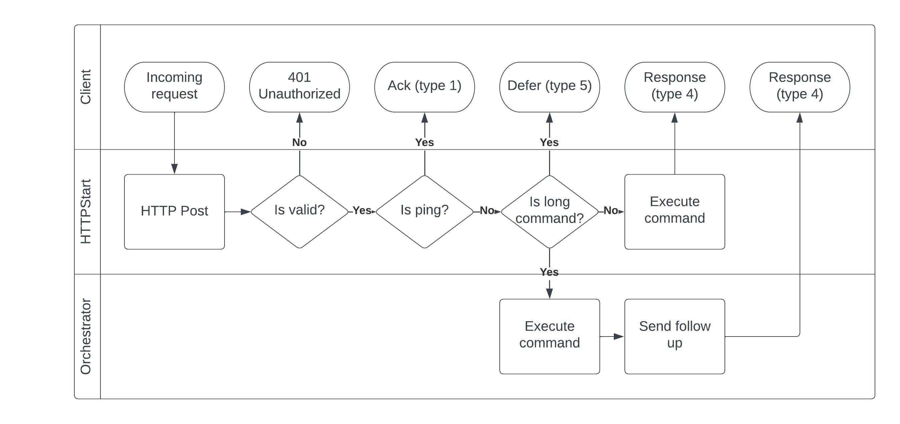

Slide 12
Azure Function code demo…

Slide 13
Creating a Discord Bot
Create Discord App
Bot -> Add bot
Oauth2 -> URL Generator ->
bot
application.commands
bot\send messages
Add HttpStart URI to Interactions Endpoint URL

Slide 14
Dealing with frostbite
PowerShell based Azure Functions have a long cold start
Monitor Function
Every 5m
Review Code

Slide 15
Full function code review…

Slide 16
Adding Commands

Slide 17
Adding commands demo…

Slide 18
Evolution
Queue based
Building a Discord Bot in PowerShell and Azure Functions
Devin Rich
Command is passed off via a queue
Very slow, more reliable than HTTP POST chain
Durable Function
Command is passed off via New-Orchestration
Very storage intensive (expensive)
HTTP POST chain
Command is passed off via HTTP POST
Fast, but requires function keys and -TimeoutSec

